Slide 1
Software design document
Nitish Bhardwaj
MedVoice

Slide 2
Agenda
Introduction
System overview
Architectural Design
Requirements
Trade study

Slide 3
1. Introduction
Purpose
This presentation describes the system/Architectual design of Medvoice app and how to get user location data.
Scope
Provide possible options and solution for our goal.
Product functions
The data collected will be display on the map and will be used to create a heat map of similar locations.

Slide 4
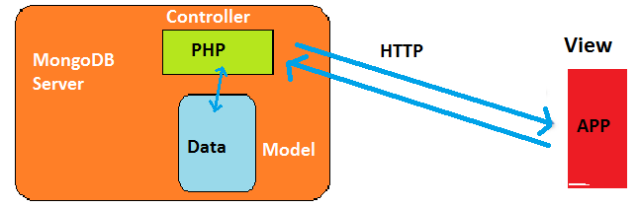
Architectural design
Model View controller (MVC)
Separates data layer from presentation layer.
Separation is useful for code reusability and app maintenance.

Slide 5
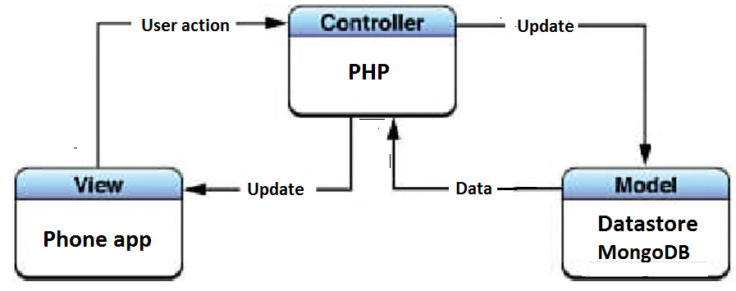
Architectural Design
Controller: PHP acting as an intermediate process which communicates back
and forth with the database and updates information to the view.
View: The front end graphical
interface of the mobile
application
Model: The back end database
hosting the data
(MySql/MongoDB)

Slide 6
Design Rationale
We will be using HTML Geolocation, Google location services API (android apps) and core location framework (iOS platform)
To display the result in a map, we will need access to a map service, like Google Maps/Apple maps.
We will use Google maps Android API and Google maps iOS API

Slide 7
Requirements
Request user permission.
Frequency of data collected?
Minimum time
Minimum distance
When do we want to start listening?
When do we want to stop listening?
Updates when the app is not in foreground?
Passive and active location receivers.

Slide 8
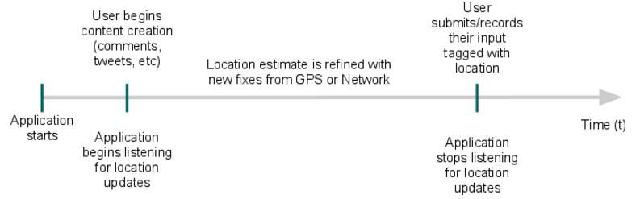
Model for the best data
Getting good user data while preserving battery life.
Getting best accuracy of location.

Slide 9
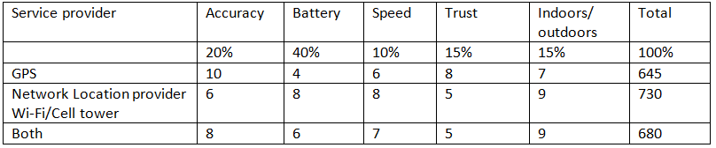
Trade Study
Passive location receiver: Get updates even when app is turned off, less battery
consumption.

